Slide 1
CHAPTER 01
INDIA: SIZE AND LOCATION
CLASS IX, GEOGRAPHY

Slide 2

Table of Contents
India$′$s Size and Location
Geographically
01.
India’s Location
Basics, Geographical coordinates, Zone
02.
Its Size
Landmass, Area, Coastal boundary
03.
India and the World
Comparison with the other countries
04.
Its Neighbours
Neighbouring countries and advantages of sharing boundaries

Slide 3
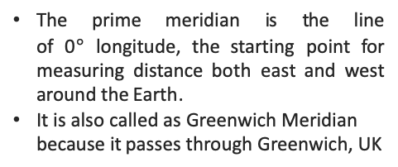
Hemispheres of Earth and Lines dividing them
India$′$s Size and Location
Geographically
PRIME MERIDIAN OR GREENWICH MERIDIAN LINE
WESTERN AND EASTERN HEMISPHERE
NORTHERN AND SOUTHERN HEMISPHERE
The prime meridian is the line of 0$°$ longitude, the starting point for measuring distance both east and west around the Earth.
It is also called as Greenwich Meridian because it passes through Greenwich, UK
Half portion of the earth lying on the west side of prime meridian is called as Western Hemisphere while remaining half portion on the east side of prime meridian is called as Eastern Hemisphere
Half portion of the earth lying above equator in the north is called as Northern Hemisphere while remaining half portion below equator is called as Southern Hemisphere
EQUATOR
Imaginary line that circle the earth halfway between the North Pole and the South Pole, at 0 degrees latitude.

Slide 4
India$′$s Size and Location
Major Lines and Zones on Earth
Geographically

Slide 5
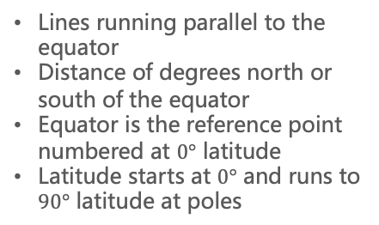
Latitude Longitude
India$′$s Size and Location
Geographically
Click it
LATITUDE
Lines running parallel to the equator
Distance of degrees north or south of the equator
Equator is the reference point numbered at $0°$ latitude
Latitude starts at $0°$ and runs to $90°$ latitude at poles
LONGITUDE
Coordinates are often expressed as two sets of numbers. The first number is always the latitude and the second is the longitude.
Any coordinate with N or S will be latitude while any coordinate with W or E will be longitude
Lines running in north-south direction
Also known as Meridians and are equal in length
Cross equator at right angle

Slide 6
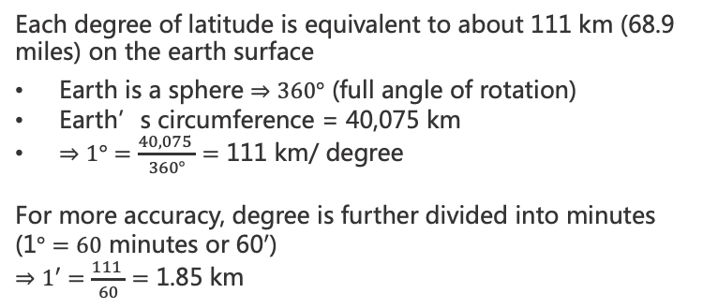
Degree of Latitude and Longitude
India$′$s Size and Location
Geographically
Each degree of latitude is equivalent to about 111 km (68.9 miles) on the earth surface
Earth is a sphere $⇒360°$ (full angle of rotation)
Earth’s circumference = 40,075 km
$⇒1°=\frac{40,075 }{360°}=$ 111 km/ degree
For more accuracy, degree is further divided into minutes (1$°=60$ minutes or 60$′$)
$⇒1′=\frac{111 }{60}=$ 1.85 km
LATITUDE
Degree of latitude cover same distance everywhere
LONGITUDE
Degree of longitude vary with location
It is maximum at 111 km at equator while close to 0 km at the poles

Slide 7
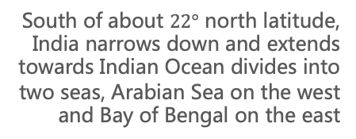
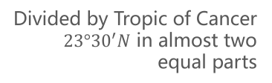
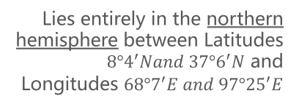
About India: Geographic Overview
India$′$s Size and Location
Geographically
Landmass
Location Coordinates
7th largest country which occupies 2.4% (3.28 million sq. km) of world’s landmass area and supports 16.2% of the worlds’ human population
Lies entirely in the northern hemisphere between Latitudes $8°4^{′}Nand 37°6^{′}N$ and Longitudes $68°7^{′}E and 97°{25}^{′}E$
Intersected by Tropic of Cancer
Land and Coastal boundary
Divided by Tropic of Cancer $23°{30}^{′}N$ in almost two equal parts
15,200 km land boundary and 7516.6 km of coastal line including mainland of A&N Islands and Lakshadweep
Island, Sea and Ocean in the South
South of about $22°$ north latitude, India narrows down and extends towards Indian Ocean divides into two seas, Arabian Sea on the west and Bay of Bengal on the east
In Southeast, Andaman and Nicobar Islands lie in the Bay of Bengal. . In Southwest, Lakshadweep Islands lie in Arabian Sea.

Slide 8
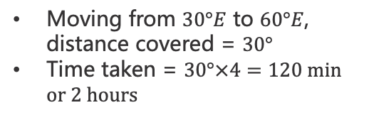
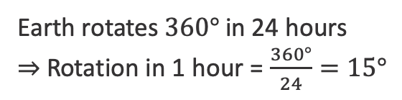
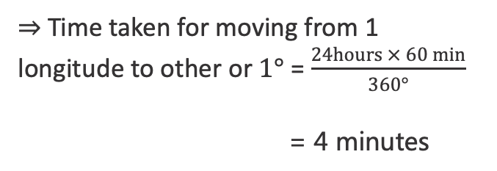
Time Zones: Calculations to know
India$′$s Size and Location
CLICK IT
Geographically
Number of Latitudinal lines = 90 + 90 +1 (equator) = 181
Number of Longitudinal lines = 360 (including prime meridian)
Earth rotates $360°$ in 24 hours
$⇒$ Rotation in 1 hour = $\frac{360°}{24}=15°$
Moving from $30°E$ to $60°E$, distance covered = $30°$
Time taken = $30°×4=120 min$ $or 2 hours$
$⇒$ Time taken for moving from 1 longitude to other or $1°$ = $\frac{24hours × 60 min}{360°}$
= 4 minutes

Slide 9
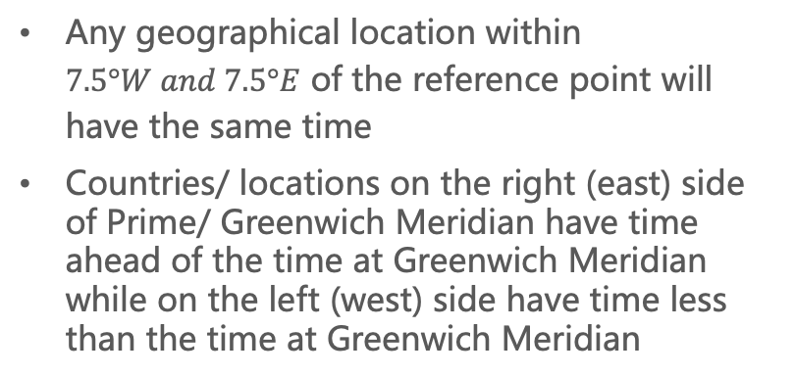
International Time Zones: How they are calculated
India$′$s Size and Location
Geographically
International Meridian Conference (26 countries) was a conference held in October 1884 in Washington D.C. (USA) to determine a prime meridian for international use.
Any geographical location within $7.5°W and 7.5°E$ of the reference point will have the same time
Countries/ locations on the right (east) side of Prime/ Greenwich Meridian have time ahead of the time at Greenwich Meridian while on the left (west) side have time less than the time at Greenwich Meridian
ELA – East Gain Add; WLS – West Less Subtract
Every $15°$ movement time changes by an hour
Question: A person is at $30°W at 2pm$, then at what time will s/he be at $15°E$?
Answer: Distance travelled in degrees = $30°+15°=45°$;
Time taken = $45°×4=180 minutes or 3 hours⇒time at 15°W will be 5pm$

Slide 10
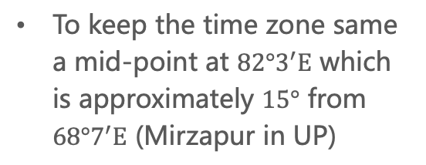
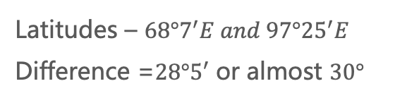
Indian Standard Time: GMT + 5:30
India$′$s Size and Location
Geographically
Latitudes – $68°7^{′}E and 97°{25}^{′}E$
Difference =$28°5′$ or almost $30°$
To keep the time zone same a mid-point at $82°3^{′}E$ which is approximately $15°$ from $68°7^{′}E$ (Mirzapur in UP)
The time gap between Gujarat in the west and Arunachal Pradesh in the east is 2 hours because latitudinal extent influences the duration of day and night (reason for proposing IST-II)

Slide 11
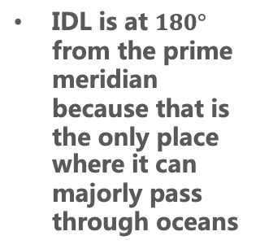
International Date Line
India$′$s Size and Location
Geographically
International Date line is an imaginary line of navigation on the surface of earth that runs from North Pole to South Pole and demarcates the change of one calendar day to the next.
IDL is at $180°$ from the prime meridian because that is the only place where it can majorly pass through oceans
IDL is not made to pass from any country to avoid the problem of having two different dates at one place

Slide 12
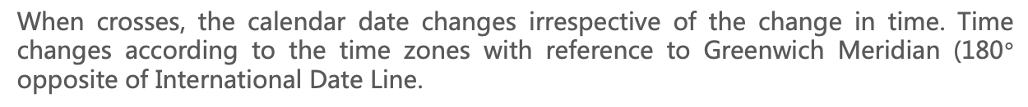
International Date Line
India$′$s Size and Location
Geographically
When crosses, the calendar date changes irrespective of the change in time. Time changes according to the time zones with reference to Greenwich Meridian (180$°$ opposite of International Date Line.
When crossed from West to East, one day is subtracted from the calendar date
When crossed from East to West, one day is added from the calendar date

Slide 13
India and the World
India$′$s Size and Location
Geographically
India is located in the centre of the World between East and West Asia
Routes across the Indian ocean connect the countries of Europe in the West and connect the countries of East Asia
Indian Ocean has its name from India as it share the largest coastal line with India
Piece of land surrounded by water on three sides
Deccan Peninsula helps India establish close contact with the West Asia, Africa and Europe from the Western Coast and with South-east and East Asia from the Eastern Coast

Slide 14
India and the World
India$′$s Size and Location
Geographically
Land routes in India are much older than the sea routes
Land routes helped India exchange of ideas and for trade purposes since ancient times
Influence of Greek sculpture and architectural styles of dome and minarets from West Asia can be seen in different parts of India
India comprises of 28 states and 9 UTs

Slide 15
India and the World
India$′$s Size and Location
Geographically
India shares its boundaries with:
Northwest: Pakistan and Afghanistan
North: China, Nepal and Bhutan
East: Myanmar and Bangladesh
South: Sri Lanka and Maldives
Sri Lanka is separated from India by a narrow channel of sea formed by the Palk Strait and the Gulf of Mannar

Slide 16
From the Chapter: Good to Know
India$′$s Size and Location
Geographically
The Southernmost point of the Indian Union “Indira Point”was submerged under the sea water in 2004 during Tsunami
Since the opening of Suez Canal in 1869, India’s distance from Europe has been reduced by 7,000 km
Before 1947, there were two types of states in India – provinces (ruled by Britishers) and princely states (ruled by local rulers)

Slide 17
Thank you for
watching and listening.

